Slide 1
Clipping
Nancy Victor
Assistant Professor
SITE, VIT University,
Vellore

Slide 2
CLIPPING
Any procedure that identifies those portions of a picture that are either inside or outside of a specified region of space is referred to as a clipping algorithm,or simply clipping.
The region against which an object is to clipped is called a clip window.

Slide 3
CLIPPING
For the viewing transformation, we want to display only those picture parts that are within the window area.
Everything outside the window is discarded.
Clipping algorithms can be applied in world coordinates, so that only the contents of the window interior are mapped to device coordinates.
Alternatively, the complete world-coordinate picture can be mapped first to device coordinates, or normalized device coordinates, then clipped against the viewport boundaries.

Slide 4
TYPES OF CLIPPING
Point Clipping
Line Clipping (straight-line segments)
  Cohen-Sutherland
  Liang-Barsky
  Nicholl-Lee-Nicholl
Area Clipping (polygons)
  Sutherland-Hodgeman
  Weiler-Atherton
Curve Clipping
Text Clipping

Slide 5
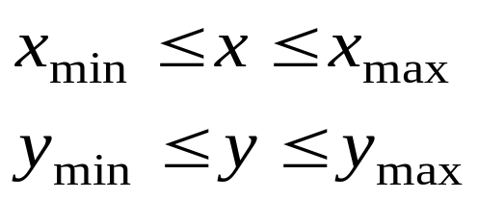
POINT CLIPPING
Assuming that the clip window is a rectangle in standard position, we save a point P = (x, y) for display if the following inequalities are satisfied:
where the edges of the clip window can be either the world-coordinate window boundaries or viewport boundaries.
If any one of these four inequalities is not satisfied, the point is clipped (not saved for display).

Slide 6
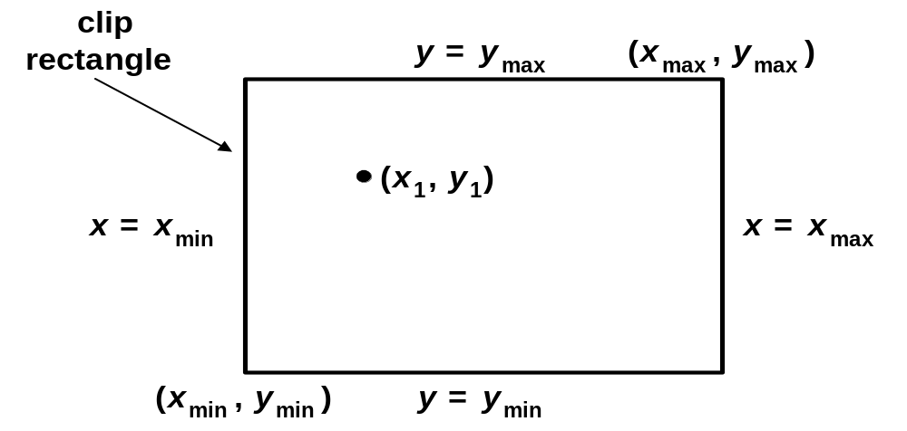
Point Clipping
For a point (x,y) to be inside the clip rectangle:

Slide 7
LINE CLIPPING PROCEDURE
First, we can test a given line segment to determine whether it lies completely inside the clipping window.
If it does not, we try to determine whether it lies completely outside the window.
Finally, if we cannot identify a line as completely inside or completely outside, we must perform intersection calculations with one or more clipping boundaries.
We process lines through the "inside-outside'' tests by checking the line endpoints.
A line with both endpoints inside all clipping boundaries is saved.
A line with both end points outside any one of the clip boundaries is outside the window.

Slide 8
LINE CLIPPING PROCEDURE
Basic algorithm:
Accept lines that have both endpoints inside the region.
Reject lines that have both endpoints less than x_{min} or y_{min} or greater than x_{max} or y_{max}.
Clip the remaining lines at a region boundary and repeat the previous steps on the clipped line segments.

Slide 9
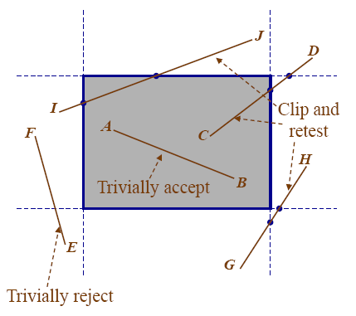
LINE CLIPPING PROCEDURE

Slide 10
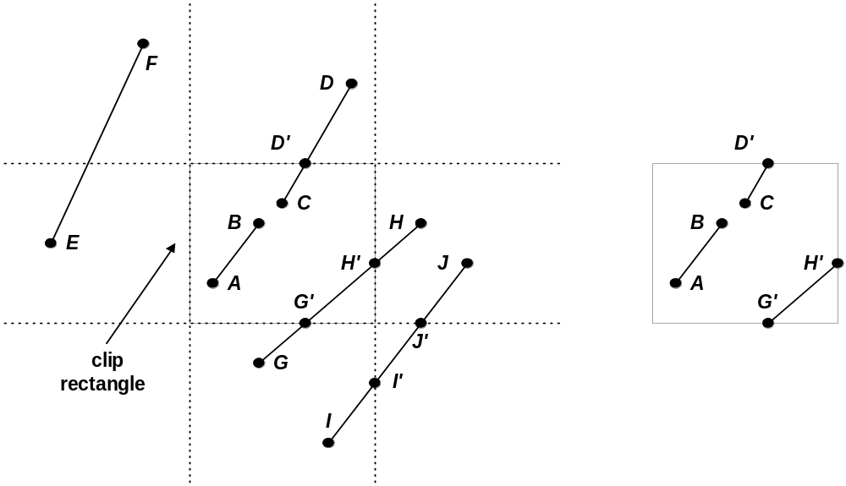
Line Clipping
Cases for clipping lines

Slide 11
COHEN-SUTHERLAND LINE CLIPPING
Every line endpoint in a picture is assigned a four-digit binary code, called a region code, that identifies the location of the point relative to the boundaries of the clipping rectangle.
Each bit position in the region code is used to indicate one of the four relative coordinate positions of the point with respect to the clip window: to the left, right, top, or bottom.
By numbering the bit positions in the region code as 1 through 4 from right to left, the coordinate regions can be correlated with the bit positions as
bit 1: left
bit 2: right
bit 3: below
bit 4: above

Slide 12
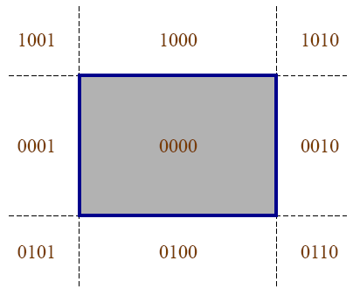
COHEN-SUTHERLAND LINE CLIPPING
Assign a 4-bit code to each endpoint c0, c1based on its position:
1stbit (0001): if x< xmin
2ndbit (0010): if x> xmax
3rdbit (0100): if y< ymin
4thbit (1000): if y> ymax
Test using bitwise functions
if c0| c1= 0000 : accept (draw)
else if c0& c1 not equal to 0000 : reject (don’t draw)
else clip and retest

Slide 13
COHEN-SUTHERLAND LINE CLIPPING
If a point is within the clipping rectangle, the region code is 0000.
Any lines that are completely contained within the window boundaries have a region code of 0000 for both endpoints, and we trivially accept
these lines.
Any lines that have a 1 in the same bit position in the region codes for each endpoint are completely outside the clipping rectangle, and we trivially reject these lines.
A method that can be used to test lines for total clipping is to perform the logical ANDoperation with both region codes.
If the result is not 0000, the line is completely outside the clipping region.

Slide 14
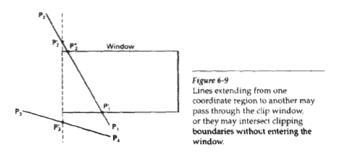
COHEN-SUTHERLAND LINE CLIPPING
Lines that cannot be identified as completely inside or completely outside a clip window by these tests are checked for intersection with the window boundaries.
We begin the clipping process for a line by comparing an outside endpoint to a clipping boundary to determine how much of the line can be discarded.
Then the remaining part of the Line is checked against the other boundaries, and we continue until either the line is totally discarded or a section is found inside the window.
We set up our algorithm to check line endpoints against clipping boundaries in the order left, right, bottom, top.

Slide 15
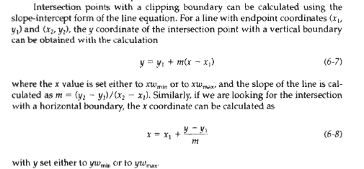
COHEN-SUTHERLAND LINE CLIPPING

Slide 16
Thank You…

